Slide 1
MYLowe’s SMART HOME
ADDITIONAL SLIDES
Early Thoughts

Slide 2
What is SMART HOME?
Early Thoughts Regarding:
The components of the SMART HOME product/service
  Hardware
  Technology
  Monitoring
With or without MYLowe’s

Slide 3
What does SMART HOME Consist Of?
The User Family has a House that they want to turn into a SMART HOME

Slide 4
What does SMART HOME Consist Of?
HARDWARE
The User Family purchases one of several starter kit options (and perhaps optional add on components) and installs sensors and other hardware throughout their house.
  This enables the physical home to send and receive data
  SMART APPLIANCES and other non-kit products also integrate with platform
Lowe’s is in the business of selling SMART HOME HARDWARE

Slide 5
What does SMART HOME Consist Of?
Data
TECHNOLOGY
The Hardware added to the home [communicates data to some machine intelligence] enabling
  The User can remotely control the home
  The System can automate aspects of home management
  Home data is available individually and in comparative aggregates with other users
This links User, Home, and Interface in a self perpetuating loop
As a ‘purchased product’ the system can ‘stand alone’ as such

Slide 6
What does SMART HOME Consist Of?
3rd Party Monitoring
MONITORING
A subscription to a 3rd Party Monitoring Service is required to break the closed loop of the User’s personal SMART HOME monitoring
Third party monitoring provides ongoing program support as well as incident assistance for break in, fire, other emergency, etc.
Lowe’s will not engage in this business (Partner: Alert Me)

Slide 7

What is MYLowe’s SMART HOME Integration?
3rd Party Monitoring
MYLowe’s Program
Data integration allows SMART HOME sensors and User input to inform larger household profile (actual vs. idealized data)
  Incorporate/prepopulate SMART HOME Data into other Applications and Tools
  ‘Skin’ SMART HOME Control as [presumed] component of MYLowe’s lifestyle suite
Uniform interface and integrated experience ‘create’ MYLowe’s omni-brand
  Insert Lowe’s into ongoing communications loop between User and SMART HOME

Slide 8
Timeline
MYLowe’s and SMART HOME
Early Thoughts Regarding:
Phased roll out of SMART HOME product/services
Phased integration of MYLowe’s brand/platform

Slide 9
Timeline
Users Continue To Opt In To MYLowe’s Key Fob Program
MYLowe’s Interface Offers Light SMART HOME Support
Robust Integration SMART HOME
3rd Party Monitoring
3rd Party Monitoring
2011
1Q12
2Q12
3Q12
4Q12
2013
There will be a phased roll out of the SMART HOME product and its integration with the MYLowe’s suite of services

Slide 10
Timeline Baseline: MYLowe’s Opt In
Users Continue To Opt In To MYLowe’s Key Fob Program
+
=
+
=
2011
1Q12
2Q12
3Q12
4Q12
2013
MYLowe’s acquisition and profiling continue throughout 2012
  New Consumers Opt In to become program Users
  Users add profile data to the system through action and input
    Learn about Consumer purchases, behavior, and preferences (Profile, Information, Resources)
    Volunteer information about House and Home Improvement Plans (Applications and Tools)
    Personal and Home Profiles linked for ‘Household’ view

Slide 11
Timeline Milestone 1: Product Launch
Users Continue To Opt In To MYLowe’s Key Fob Program
MYLowe’s Interface Offers Light SMART HOME Support
3rd Party Monitoring
2011
1Q12
2Q12
3Q12
4Q12
2013
SMART HOME will launch with a pilot roll out around the end of 1Q12
  SMART HOME will have 3rd party monitoring support
  The product/service will not feature MYLowe’s branding
    Some minimal support may exist on MYLowe’s (drive reciprocal interest)

Slide 12
Timeline Milestone 2: Program Launch
Users Continue To Opt In To MYLowe’s Key Fob Program
MYLowe’s Interface Offers Light SMART HOME Support
Robust Integration SMART HOME
3rd Party Monitoring
3rd Party Monitoring
2011
1Q12
2Q12
3Q12
4Q12
2013
Planning should begin now for the roll out of a fully integrated and MYLowe’s branded SMART HOME product/service in 2H12
  SMART HOME is a long-term strategic plank in the new concept of home ownership that MYLowe’s attempting to foster in ‘Creators’
Need to define phased scope(s) of MYLowe’s support/integration for SMART HOME

Slide 13
The Potential Relationship Between
MYLowe’s and SMART HOME
Early Thoughts Regarding:
Perceptions of MYLowe’s as a uniform suite of products/services

Slide 14
MYLowe’s User Perspective
PHYSICAL PEOPLE
AND HOUSE
MYLowe’s Experience
USER AND HOME
PROFILES
Content
Resource
Application
Tool
From the consumer’s perspective MYLowe’s provides a uniform integrated experience that contextualizes activities related to their Home and H.I.
  They don’t see individual components as isolated products/services
  (Personal Profile, Home Profile, Paint Calculator, SMART HOME)
  They see a [platform] for managing their home and their relationship to it
  (An integrated suite of modular utilities)

Slide 15
MYLowe’s User Perspective NOW
PHYSICAL PEOPLE
AND HOUSE
USER PROFILES
Opt In and Key Fob are the User’s entry point to MyLowe’s
  The User volunteers some personal data
  The User’s purchase behavior is tracked by PIN
  A User Profile is created, populated, and maintained (will be linked to household)

Slide 16
MYLowe’s User Perspective NOW
PHYSICAL PEOPLE
AND HOUSE
USER PROFILES
Perceived Value Of
MyLowe’s
Comes From
Presumed Rewards
For Program Participation
Opt In and Key Fob are the User’s entry point to MyLowe’s
  The User volunteers some personal data
  The User’s purchase behavior is tracked by PIN
  A User Profile is created, populated, and maintained (will be linked to household)
User perspective is that this is SOP for loyalty card programs and that membership/data may drive promotional offers and personalization

Slide 17
MYLowe’s User Perspective SOON
PHYSICAL PEOPLE
AND HOUSE
MYLowe’s Experience
Content
Resource
Application
Tool
NOTE:
Need to ‘finalize’ Terms
MYLowe’s provides The User with an integrated suite of
  Content: Information related to Home Improvement, Products, Topics, etc.
    Object/Category Oriented EX: About Refrigerators, Paint, Landscaping, Plumbing, etc.
  Resources: Information related to planning/executing a specific project
    Task/Result Oriented Ex: How to install [a sink], Preparing your garden for winter
  Applications: Interactive widgets for virtually managing ‘the home relationship’
    Conceptual Management Ex: Room Measurements, Paint Calculator, Project Planning
  Tools: Interactive widgets for physically managing ‘the home relationship’
    Actual Management Ex: Reminder Service, SMART HOME Remote Control

Slide 18
MYLowe’s User Perspective SOON
PHYSICAL PEOPLE
AND HOUSE
MYLowe’s Experience
Content
Resource
Perceived Value Of MyLowe’s
Comes From
User Understanding Of
Program Component
(Beyond Simple/Expected “Loyalty Card”)
Application
Tool
MYLowe’s provides The User with an integrated suite of Content, Resources, Applications, and Tools.
User perspective becomes:
  Lowe’s is a trusted source of home management/improvement supplies
  Participating in MYLowe’s provides a technology that will enable them to better manage their home and home improvement projects

Slide 19
MYLowe’s User Perspective SOON
PHYSICAL PEOPLE
AND HOUSE
MYLowe’s Experience
USER AND HOME
PROFILES
Content
Resource
Application
Tool
MYLowe’s User and Home Profiles are a logical by product of The User’s relationship to the MYLowe’s suite of offerings (Data makes it work)
  Personal Profile(s) manage the account and track purchases
  Home Profile is started and expanded as a result of engaging with MYLowe’s Applications and Tools (volunteering data is part of planning and play)
The mechanism is [somewhat] invisible to the user

Slide 20
MYLowe’s User Perspective SMART HOME
PHYSICAL PEOPLE
AND [SMART HOME]
MYLowe’s Experience
USER AND HOME
PROFILES
Content
Resource
Application
Tool
SMART HOME enables the house to communicate directly with both the User and the MYLowe’s system
  SH User can remote control the home independently of MYLowe’s membership
  Adding MYLowe’s to SMART HOME integrates [remote home management] into the revised/expanded concept of homeownership that MYLowe’s is creating
  Adding SMART HOME to MYLowe’s enables the physical home to become a data node of the integrated MYLowe’s – SMART HOME Ecosystem

Slide 21
MYLowe’s Perspective SMART HOME
PHYSICAL PEOPLE
AND [SMART HOME]
MYLowe’s Experience
USER AND HOME
PROFILES
Content
Resource
Application
Tool
The entire MYLowe’s platform/interface/brand will be created in service of two underlying strategies to drive Lowe’s consumer sales:
  Capturing personally identifiable date about the User(s) and their Home enables personalized targeting and aggregate learning
  Inserting the MYLowe’s brand into the homeowner’s ongoing practical/fantasy relationship to their home will likely drive Lowe’s purchases

Slide 22
MYLowe’s Perspective SMART HOME
PHYSICAL PEOPLE
AND [SMART HOME]
MYLowe’s Experience
USER AND HOME
PROFILES
Content
Resource
Application
Tool
The entire MYLowe’s platform/interface/brand will be created in service of two underlying strategies to drive Lowe’s consumer sales:
  Capturing personally identifiable data about User(s) and their Home enables personalized targeting and aggregate learning
  Inserting the MYLowe’s brand into the homeowner’s ongoing practical/fantasy relationship to their home will likely drive Lowe’s purchases

Slide 23
MYLowe’s Perspective SMART HOME
PHYSICAL PEOPLE
AND [SMART HOME]
MYLowe’s Experience
USER AND HOME
PROFILES
Content
Resource
Application
Tool
The entire MYLowe’s platform/interface/brand will be created in service of two underlying strategies to drive Lowe’s consumer sales:
  Capturing personally identifiable data about User(s) and their Home enables personalized targeting and aggregate learning
  Inserting the MYLowe’s brand into the homeowner’s ongoing practical/fantasy relationship to their home will likely drive Lowe’s purchases

Slide 24
SMART HOME Value To MYLowe’s
PHYSICAL PEOPLE
AND [SMART HOME]
MYLowe’s Experience
USER AND HOME
PROFILES
Content
Resource
Application
Tool
SMART HOME integration supports these two MYLowe’s objectives by:
  SMART HOME product choice ties a physical House to an ongoing data/technological relationship with management/monitoring platforms
  SMART HOME usage requires ongoing communication touch points between the User and the system. The is a benefit to fitting these with a MYLowe’s brand halo to drive program loyalty and brand affinity.

Slide 25
MYLowe’s SMART HOME Ecosystem
Early Thoughts Regarding:
Ecosystem components and their interrelationships
The User’s Journey through this ecosystem

Slide 26
The MYLowe’s SMART HOME Ecosystem
Physical
Virtual
The MYLowe’s SMART HOME Relationship
5 primary components to the MYLowe’s + SMART HOME Ecosystem
  The User
  The Home (SMART HOME Enabled)
  MYLowe’s (Interface and Applications)
  The Home Profile
  The User Profile

Slide 27
The MYLowe’s SMART HOME Ecosystem
Physical
1
Virtual
The User: The uniquely identifiable consumer(s) with whom Lowe’s is building an ongoing relationship through MYLowe’s program membership
  OBJECTIVE: Increase Lowe’s Brand Affinity and Purchases
    Opted Into program at POP and carry a Key Fob
    Need to begin/increase use of MYLowe’s online components
      Different use cases require different incentives for ongoing MYLowe’s program use

Slide 28
The MYLowe’s SMART HOME Ecosystem
Physical
2
Virtual
The Home: The uniquely identifiable house belonging to the User Family with whom Lowe’s is building an ongoing relationship through MYLowe’s program
  OBJECTIVE: Increase Lowe’s understanding of current home details and future plans
    House has abstract relationship to MYLowe’s that must be connected through User action
    SMART HOME can connect House to MYLowe’s as a data node
      Increases Lowe’s probability of acquiring ‘personally identifiable Houses’ (in addition to users)

Slide 29
The MYLowe’s SMART HOME Ecosystem
Physical
3
Virtual
MYLowe’s: The Brand Experience umbrella which contextualizes the content, resources, applications, and tools offered by Lowe’s to drive loyalty
  OBJECTIVE: Expand Lowe’s brand/relationship beyond store; shape HI thinking
    Consumer becomes User at Opt In; MYLowe’s participation grows with time/relevance
    ‘Sliding scale’ of participation depth with program defines cumulative User Experience
      The sum is greater than the parts (but parts must reflect and refer back to total program)

Slide 30
The MYLowe’s SMART HOME Ecosystem
4
Physical
Virtual
The Home Profile: The information about the Home and its contents as provided by the User’s ongoing relationship with MYLowe’s program
  OBJECTIVE: Insert Lowe’s brand into HI planning and fantasy; track data/use
    Key Fob tracked purchases are added to Home
    Utilities/Activities encourage User to input Home data into MYLowe’s system
      Project planning/estimation helps bridge Home data to Lowe’s sales of HI supplies

Slide 31
The MYLowe’s SMART HOME Ecosystem
Physical
5
Virtual
The User Profile: The information about the User, their ourchases, behavior, and preferences collected through ongoing relationship with MYLowe’s program
  OBJECTIVE: Utilize personalization and channel choice to drive Affinity/Purchases
    Generate insight into consumers as individuals and in aggregate
    Structure the User’s relationship to the MYLowe’s program
      Single sign on, prepopulated data, preferences

Slide 32
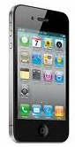
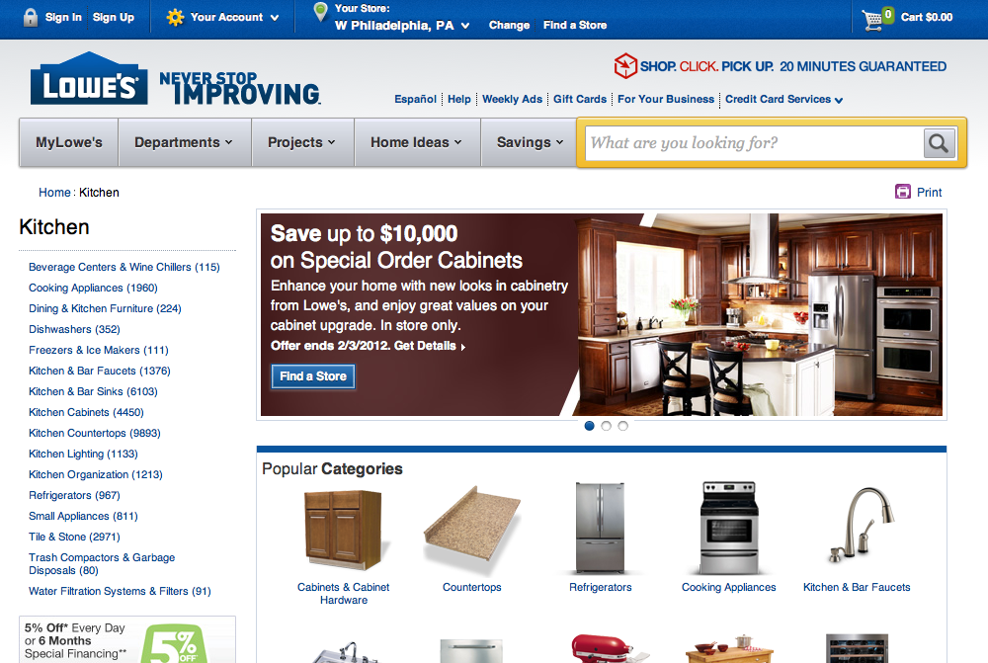
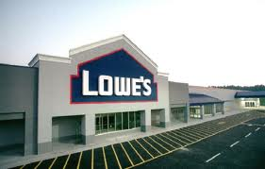
The SH Ongoing Purchase Ecosystem
Physical
Virtual
The Lowe’s (store, app, or .com) commerce relationship is always present just outside the conceptual (branded but not commercial) MYLowe’s loop

Slide 33
The SH Ongoing Purchase Ecosystem
Physical
Virtual
The Lowe’s (store, app, or .com) commerce relationship is always present just outside the conceptual (branded but not commercial) MYLowe’s loop
The underlying/implied business goal of MYLowe’s is to
  Drive user to Lowe’s store, Lowe’s App, or Lowes.com for purchase
  Empower Personal/Home Profile to guide and even automate purchases

Slide 34
SH Purchase Ecosystem: User Input
1
1: MYLowe’s Brand and Interface structures the user’s relationship to their actual/idealized home (Virtual Ideas for a Physical House)
  1A: Personal Profile is populated by the user’s inputs and actions
    Guides personalization and targeting
  1B: Home Profile combines user data (purchases) with data inputted about home
    Inspires/structures purchase behavior through HI project planning

Slide 35
SH Purchase Ecosystem: User Input
1
1A
1: MYLowe’s Brand and Interface structures the user’s relationship to their actual/idealized home (Virtual Ideas for a Physical House)
  1A: Personal Profile is populated by the user’s inputs and actions
    Guides personalization and targeting
  1B: Home Profile combines user data (purchases) with data inputted about home
    Inspires/structures purchase behavior through HI project planning

Slide 36
SH Purchase Ecosystem: User Input
1B
1
1A
1: MYLowe’s Brand and Interface structures the user’s relationship to their actual/idealized home (Virtual Ideas for a Physical House)
  1A: Personal Profile is populated by the user’s inputs and actions
    Guides personalization and targeting
  1B: Home Profile combines user data (purchases) with data inputted about home
    Inspires/structures purchase behavior through HI project planning

Slide 37
SH Purchase Ecosystem: House Input
2
2: MYLowe’s Brand and Interface structures the user’s relationship to their actual/idealized home (a suite of tools for HI and Home management)
  2A: SMART HOME allows the house to provide data to MYLowe’s profiles
    SMART HOME is a logical integrated component of ‘new MYLowe’s home ownership mindset’
  2B: SMART HOME can communicate with the user independent of MYLowe’s
    MYLowe’s platform NOT required by SMART HOME technology/service

Slide 38
SH Purchase Ecosystem: House Input
2A
2A
2A
2
2A
2: MYLowe’s Brand and Interface structures the user’s relationship to their actual/idealized home (a suite of tools for HI and Home management)
  2A: SMART HOME allows the house to provide data to MYLowe’s profiles
    SMART HOME is a logical integrated component of ‘new MYLowe’s home ownership mindset’
  2B: SMART HOME can communicate with the user independent of MYLowe’s
    MYLowe’s platform NOT required by SMART HOME technology/service

Slide 39
SH Purchase Ecosystem: House Input
2A
2
2A
2A
2B
2: MYLowe’s Brand and Interface structures the user’s relationship to their actual/idealized home (a suite of tools for HI and Home management)
  2A: SMART HOME allows the house to provide data to MYLowe’s profiles
    SMART HOME is a logical integrated component of ‘new MYLowe’s home ownership mindset’
  2B: SMART HOME can communicate with the user independent of MYLowe’s
    MYLowe’s platform NOT required by SMART HOME technology/service

Slide 40
SH Purchase Ecosystem: Physical Store
3
3
Physical Consumer Purchases
3: MYLowe’s relationship and profile inspire physical consumer purchase
3A: The consumer visits a Lowe’s Store location
4: The consumer brings their purchase home or have it delivered

Slide 41
SH Purchase Ecosystem: Physical Store
3
3
3A
Physical Consumer Purchases
3: MYLowe’s relationship and profile inspire physical consumer purchase
3A: The consumer visits a Lowe’s Store location
4: The consumer brings their purchase home or have it delivered

Slide 42
SH Purchase Ecosystem: Physical Store
3
3
3A
4
Physical Consumer Purchases
3: MYLowe’s relationship and profile inspire physical consumer purchase
3A: The consumer visits a Lowe’s Store location
4: The consumer brings their purchase home or have it delivered

Slide 43
SH Purchase Ecosystem: Virtual Storefront
3
3
Virtual Consumer Purchases
3: MYLowe’s relationship and profile inspire virtual consumer purchase
3A: The Personal Profile personalizes Lowes.com experience and suggests targeted purchases based on past behavior and stated needs/wants
3B: The Home Profile suggests and automates purchases based on needs
4: The purchase is delivered to the consumer’s home

Slide 44
SH Purchase Ecosystem: Virtual Storefront
3B
3
3A
3
Virtual Consumer Purchases
3: MYLowe’s relationship and profile inspire virtual consumer purchase
3A: The Personal Profile personalizes Lowes.com experience and suggests targeted purchases based on past behavior and stated needs/wants
3B: The Home Profile suggests and automates purchases based on needs
4: The purchase is delivered to the consumer’s home

Slide 45
SH Purchase Ecosystem: Virtual Storefront
3B
3
3A
3
4
Virtual Consumer Purchases
3: MYLowe’s relationship and profile inspire virtual consumer purchase
3A: The Personal Profile personalizes Lowes.com experience and suggests targeted purchases based on past behavior and stated needs/wants
3B: The Home Profile suggests and automates purchases based on needs
4: The purchase is delivered to the consumer’s home

Slide 46
The User’s Journey Into The SH Ecosystem
The Consumer has a HI idea for their home
They choose a Lowe’s channel to purchase supplies

Slide 47
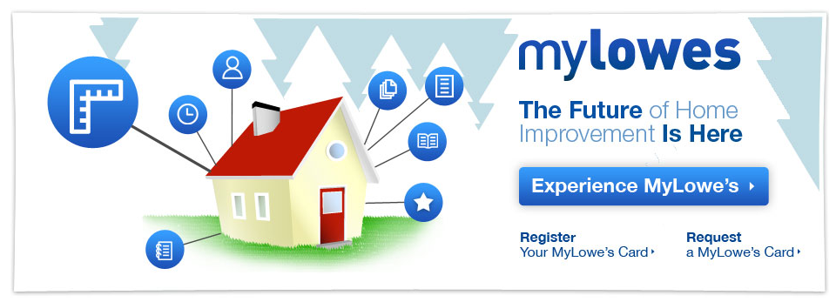
The User’s Journey Into The SH Ecosystem
The Consumer becomes aware of MYLowe’s program
  Incentive/motivation for Opt In varies with Use Case
  User perception structured by associate interaction and support materials

Slide 48
The User’s Journey Into The SH Ecosystem
Consumer Opts In to MYLowe’s program
  Issued a Key Fob as MYLowe’s User

Slide 49
The User’s Journey Into The SH Ecosystem
Key Fob and Opt In allow Lowe’s to track Individually Identifiable Users
  Data for purchases paired with Key Fob added to User’s Profile
  User enters additional data into User Profile

Slide 50
The User’s Journey Into The SH Ecosystem
MYLowe’s provides lightly branded Content, Resources, Applications, and Tools to inspire and guide HI planning and execution
  Informed by User Profile behavior, preferences, and personalization

Slide 51
The User’s Journey Into The SH Ecosystem
MYLowe’s value/ease allows it to become an integral part of the Consumer’s Home management and HI Planning
  Project-related usage starts User building/expanding Home Profile (current/future)

Slide 52
The User’s Journey Into The SH Ecosystem
Personal Profiles(s) and Home Profile can be combined into a ‘Household’
Data about the Household (and it’s components as relevant) inform MYLowe’s functionality (prepopulate, unlock, etc.) and preferences

Slide 53
The User’s Journey Into The SH Ecosystem
MYLowe’s Profiles and Preferences then message the consumer about real world actions/purchases (reminder, project plan, shopping list, promotion)
The User must make the connection back to their physical Home

Slide 54
The User’s Journey Into The SH Ecosystem
MYLowe’s makes Lowe’s sales channels top of mind as ‘the first choice in home improvement’.
User can make purchases through MYLowe’s interface or visit a store

Slide 55
The User’s Journey Into The SH Ecosystem
Monitoring
Adding SMART HOME makes the House a data collecting/sharing node
  With MYLowe’s (compare to data provided to Home Profile)
  With external 3rd Party Monitoring or User directly

Slide 56
The User’s Journey Into The SH Ecosystem
Monitoring
It is possible to Use SMART HOME without MYLowe’s
  This is the experience of other consumers who do not purchase through Lowe’s
  Lowe’s will sell add on hardware (possible benefit to offering MYLowe’s integration)

Slide 57
The User’s Journey Into The SH Ecosystem
Monitoring
Integrating SMART HOME with MYLowe’s Household Profile enables Lowe’s to seamless incorporate SMART HOME functionality, controls, and messaging within the Lowe’s omni-brand experience
  More an overt benefit to Lowe’s than the User (User benefit is ‘one stop shop’)

Slide 58
The User’s Journey Into The SH Ecosystem
Monitoring
If they choose to upgrade hardware/service, SMART HOME is simply another optional feature/benefit of MYLowe’s program participation
  External Monitoring still required

Slide 59
The User’s Journey Into The SH Ecosystem
Monitoring
MYLowe’s SMART HOME integration adapts the existing repeated interaction model required by SH Use to create additional brand touch points
  This keeps Lowe’s top of mind for inspiration and purchase

Slide 60
A Two-Stage User Journey
At its broadest interpretation, regardless of the many variables regarding branding, roll out, etc. The SMART HOME User Journey has two primary stages:
All awareness, consideration, and decision leading up to PURCHASE
  Significant in driving initial product sale and customer acqusition
PURCHASE as the gateway to use and expansion
  Significant for the lifecycle value of Consumer Relationship maintained by MYLowe’s + SMART HOME

Slide 61
Stages of The SMART HOME User Journey
Activation and Preconditioning
Awareness and Interest
Go to [Lowe’s] Channel Choice
Consideration and Decision
Purchase and Delivery
Activation and Installation
Configuration and Use
Optimization and Expansion
Core Journey
Retention and Lifetime Value

Slide 62


Visualizing The User Journey
$
$
$
!
!
0
1
2
3
4
5
00
A two-stage User Journey overlapping individual Milestones and Tasks
  Pre-PURCHASE: The Consumer decides to buy SMART HOME from Lowe’s
  PURCHASE
  Post-PURCHASE: The Consumer becomes a SMART HOME USER

Slide 63
A Two-Stage Journey
Interest In “Smart Home” Solution
Purchase
MYLowe’s SMART HOME
Product User
BOX
(Packaging)
CONTENTS
(Product)
Awareness to Consideration to Decision
Activation to Installation to Integration
Stage 1: Get the user to the box
  Initial Objective: Drive purchase
Stage 2: The open box initiates next stage of journey
  Growth Objective: Develop ongoing relationship with owner/user
Purchase is the fulcrum that balances the ‘before and after’ experiences

Slide 64
Viral, Social, News
Competitor Advertising
MYLowe’s SMART HOME Advertising
General Cultural Awareness Of
SMART HOME CONCEPT
Get Target Customer Into Lowe’s Sales Channel
In Store Display, Signage, etc.
Lowes.com product catalogue, etc.
SMART HOME Section
Sales Associate
Packaging
Product
BOX
(Packaging)
Outreach
Conversion

Slide 65
Installation Experience
Physical Installation Components
Online Account Activation
Hand Off To Online
Customer Support to ‘get over the hurdle’
Successful Installation & Activation
USE: Getting It To Work
Integrating SMART HOME Into Lifestyle
Transition From Toy To Tool
Optimize & Expand Roll In Lifestyle
Add On Sale Of Additional Products/Services
Package Contents
Instructions
CONTENTS
(Product)
Parallel Online Experience

Slide 66
A Three-Phase User Journey
The SMART HOME User Journey has three primary phases:
All awareness, consideration, and decision leading up to PURCHASE
  Significant in driving initial product sale and customer acqusition
PURCHASE as the gateway to use and expansion
  Significant for the lifecycle value of Consumer Relationship maintained by MYLowe’s + SMART HOME

Slide 67
Stages of The SMART HOME User Journey
Activation and Preconditioning
Awareness and Interest
Go to [Lowe’s] Channel Choice
Consideration and Decision
Purchase and Delivery
Activation and Installation
Configuration and Use
Optimization and Expansion
Core Journey
Retention and Lifetime Value

Slide 68
Visualizing The User Journey
$
$
$
!
!
0
1
2
3
4
5
00
Three Overlapping Phases composed of Individual Milestones and Tasks
  Activation from ‘Cold Start’ to ‘SMART HOME’
  Needs Assessment and Purchase Experience
  Installation, Use, Modification

Slide 69

Step 0: Awareness and Interest
Requires Further Discussion:
This Step Is An [Implied] Precursor
To [Most] User Journeys
Journey Begins When
User Enters A Lowe’s Channel
0
1

Slide 70
Step 1: Go To [Lowe’s] Channel Choice
Online, Mobile
GOAL:
Acquire
MYLowe’s
Opt In
!
I think/know I need
!
Conceptual Activation
One or both lead to a consumer who is ‘activated’
to be receptive to the SMART HOME value proposition
(Awareness, Openness, Interest, Desire)
!
OBJECTIVE:
Create Lowe’s
Customers
Lifetime Value
Even Without
SMART HOME
Purchase
I want what I didn’t know I needed
Media Activation
Lowe’s Store
1
2

Slide 71
Step 2: Consideration and Decision
Online Research
Purchase
Online
EDUCATION
Online Demos
!
Compare Product/Store Online
EDUCATION GAP
Information/Influence
required to ‘tip’ the
SMART HOME
Purchase Decision
VIRTUAL
$
PHYSICAL
Activated Consumer
PURCHASE
Talk To Associate
Physically Interact With Product
Purchase
In Store
Comparison Shop Stores/Products
2
3

Slide 72
Step 3: Purchase and Delivery
Purchase
Online
$
Online Demos
Inform Install
EDUCATION GAP
Information/Influence
required to ‘tip’ the
SMART HOME
Purchase Decision
EDUCATION GAP
DIY vs. DIFY
$
Continuum of DIY Proficiency
Get Product Home
Physically
Interact With
Product
Choose Product
Purchase
In Store
3
4

Slide 73
Step 4: Activation and Installation
$
Installation
Experience
Experience Scheduling
Professional Installation
Does It
Work?
DIY
Use
ONGOING SUPPORT
Continuum of DIY Proficiency
?
Get Product Home
DIY
3rd Party Monitoring
Installation
Experience
Experience Unpacking
Box and Contents
Activate Service
Online
MYLowe’s SMART HOME Support/Intergration
4
5

Slide 74
Step 5: Configuration and Use
Requires Further Exploration Of:
Product Details, Components, Add Ons
Alternate Use Case Scenarios
5
00

Slide 75

Step 00: Optimization and Expansion
Requires Further Exploration Of:
Product Details, Components, Add Ons
Alternate Use Case Scenarios
00
?

Slide 76
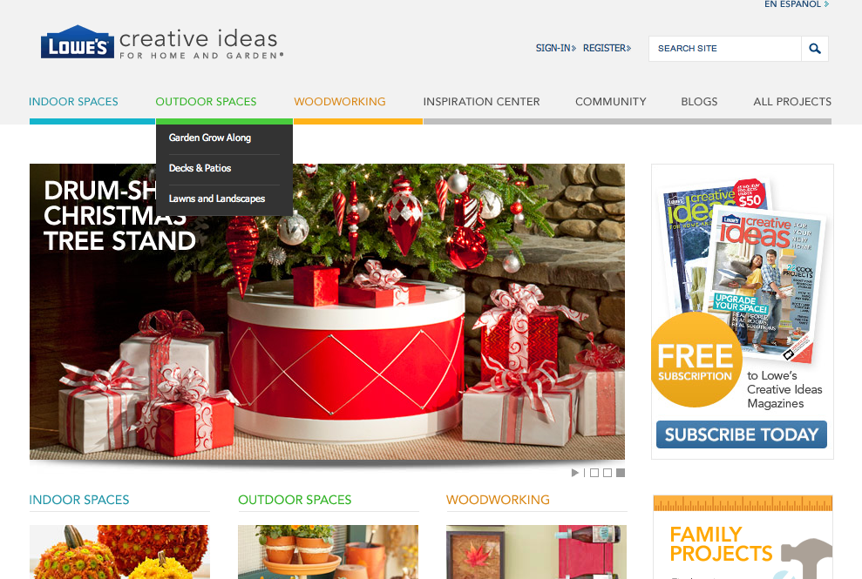
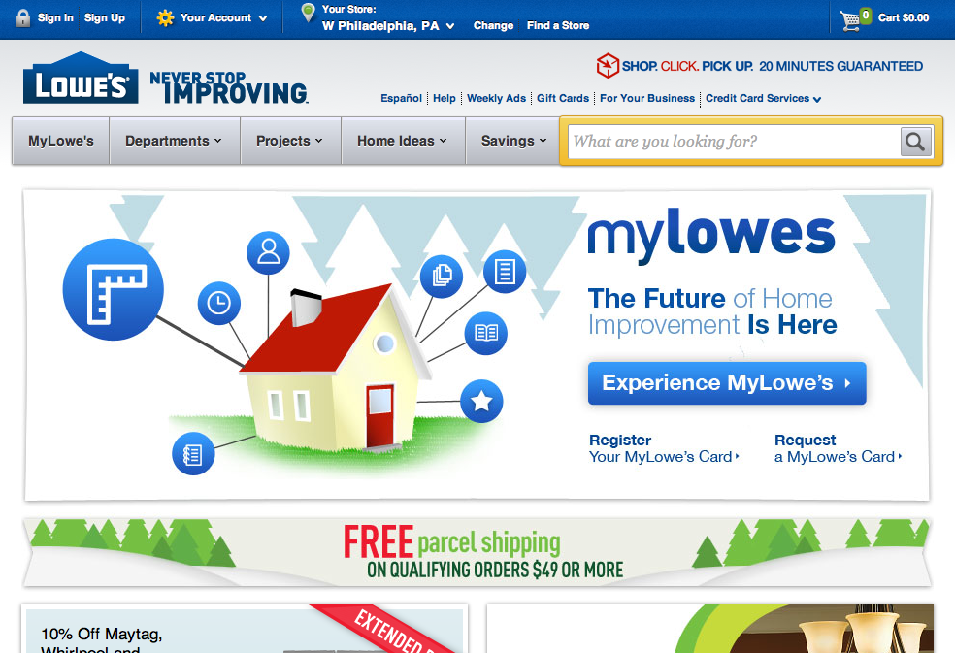
Using Inspiration To Drive Sales
Lowes.com
eCommerce
Product
Catalogue
(Store Visit)
Lowe’s Creative Ideas
Lifestyle and Product
Content
MYLowe’s
Profile and Planning Resources
Lowe’s generates revenue through online in store sales
Existing: “Lowe’s Creative Ideas” drives sales through aspirational project content targeted at a neutral/generalized target audience
Future: “MYLowe’s” personalizes content delivered based on personal preferences and customized MY Home projects.
Future content integration TBD

